Slide 1
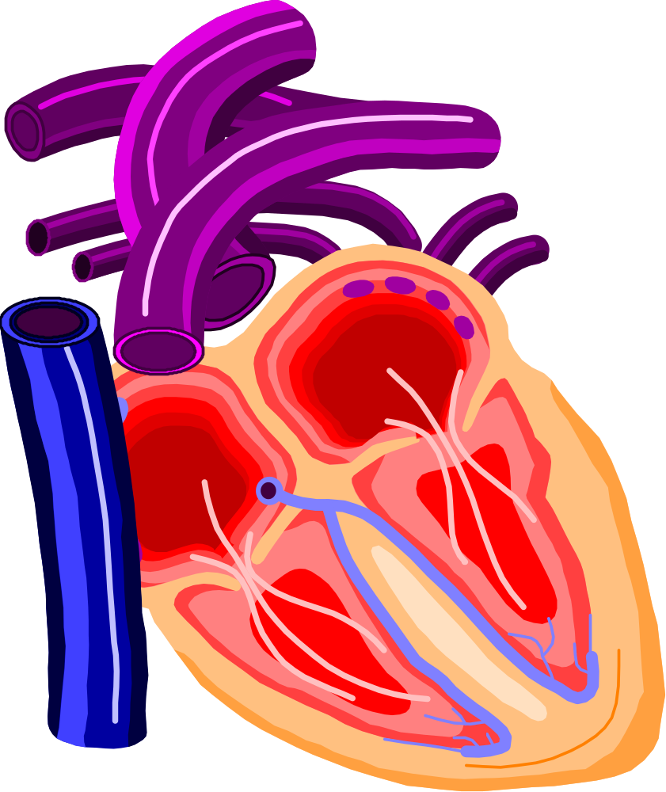
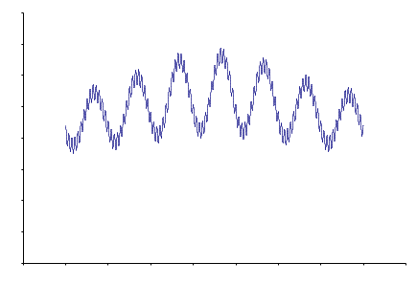
Topics for Questions
Introduction
Objectives
Why Open Source
How We Start a Project
Roadmap
Project Activity
Sensor
Piezo Film
Other Potential Implementations
Improvement Ideas
How We Perform a Project
Problems
Software
System & SW Arch. Components
Sphygmochron – Problems & Issues
What Does the Report Look Like?
Test Driven SW Development
User Stories and req. development
Usage
BP is Highly Variable
Impact on Health
Analysis
Treatment
Chronobiologic Appoach

